Slide 1
Detecting Machine-Crafted Content in Digital Media
TEAM MEMBERS:
Bellamkonda Venkata Ramana
Hemanth Pathipati
Jaya Krishna Chinthaginjala

Slide 2
Introduction
Detecting machine-crafted content in digital media has become increasingly important as artificial intelligence (AI) tools generate text, images, and videos that mimic human creativity.
With the rise of deep learning techniques and natural language processing (NLP), AI-generated content is becoming more sophisticated, making it challenging to distinguish it from human-produced media.
This challenge raises concerns about misinformation, manipulation, and the authenticity of digital media.
The development of reliable detection systems is critical to ensure trust in online content and safeguard against potential misuse.

Slide 3
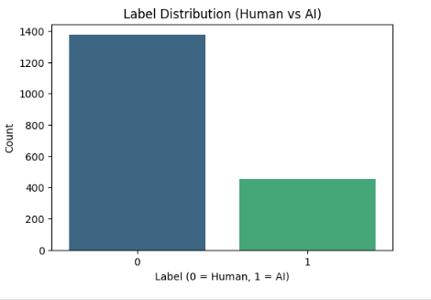
Human and AI Dataset

Slide 4
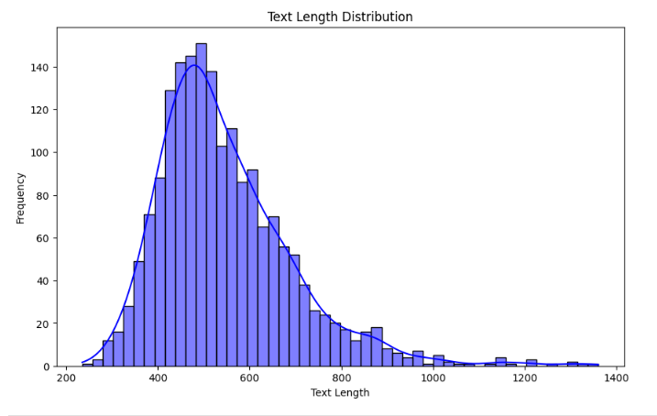
Distribution (Human vs AI)

Slide 5
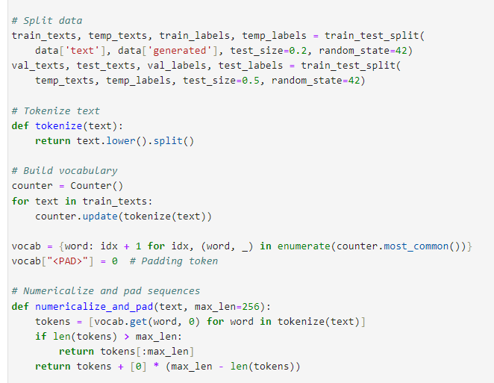
Data Processing
The data is first split into training, validation, and test sets to ensure a balanced evaluation of the model's performance.
A custom vocabulary is built from the training texts, assigning unique indices to each word and adding a padding token.
Texts are then tokenized, numericalized, and padded to a fixed length, enabling consistent input sizes for model training.

Slide 6
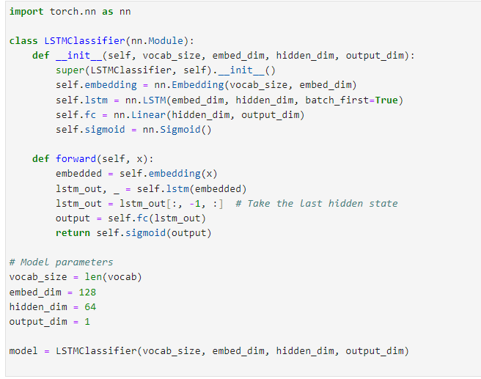
Model 1: LTSM Model
The LSTMClassifier is a neural network designed for sequence classification tasks, combining an embedding layer, an LSTM layer, and a fully connected layer.
The embedding layer converts word indices into dense vectors, while the LSTM processes these sequences to capture temporal dependencies, with the final hidden state representing the sequence.
The fully connected layer maps this representation to the output, with a sigmoid activation producing probabilities for binary classification.

Slide 7
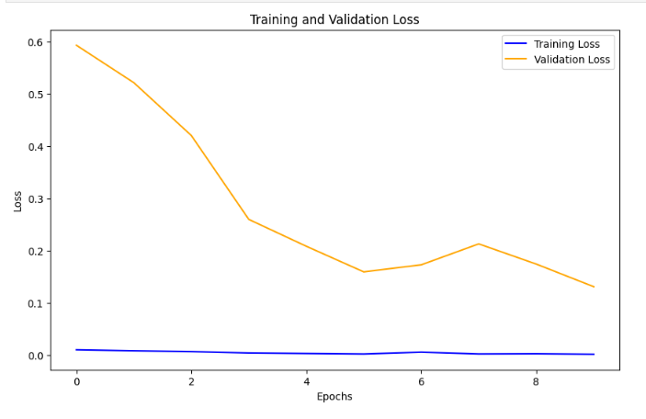
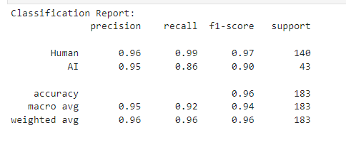
LTSM Model Performance
The model achieved high performance with a validation loss of 0.1308 and an accuracy of 96%, showing strong precision and recall for both "Human" and "AI" classes. However, the slightly lower recall for the "AI" class indicates room for improvement in detecting minority instances

Slide 8
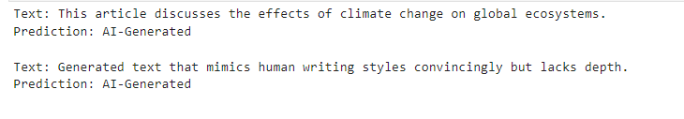
Deployment

Slide 9
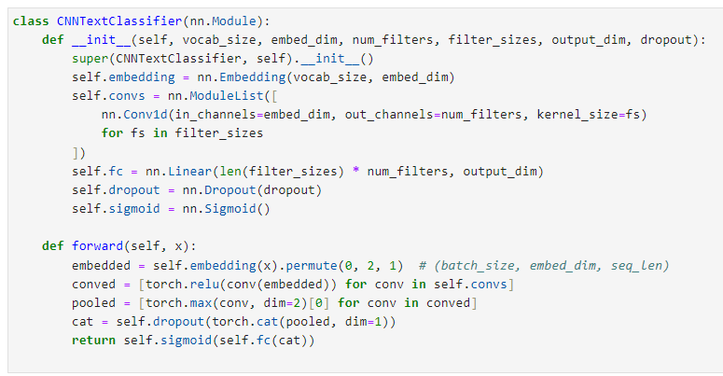
CNN Model
The CNNTextClassifier uses multiple convolutional layers with different filter sizes to capture varying n-gram features, followed by max pooling and a fully connected layer.
It incorporates dropout for regularization and uses a sigmoid activation for binary classification output.

Slide 10
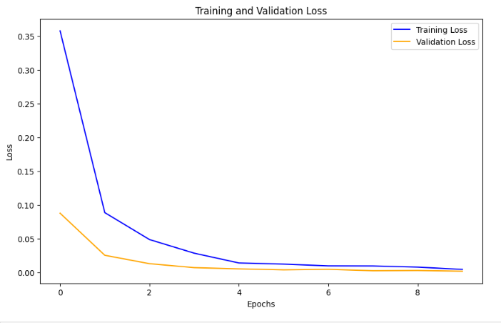
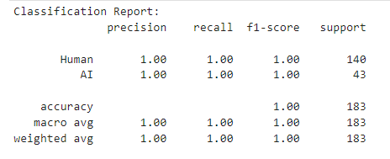
CNN Model Performance
The CNN model shows a consistent decrease in both training and validation losses, from 0.3581 and 0.0876 in epoch 1 to 0.0042 and 0.0016 in epoch 10. This indicates effective learning and strong generalization.
The CNNTextClassifier model has shown excellent performance, achieving perfect accuracy of 100% on both the training and validation sets.

Slide 11
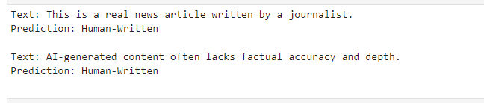
CNN Deployment

Slide 12
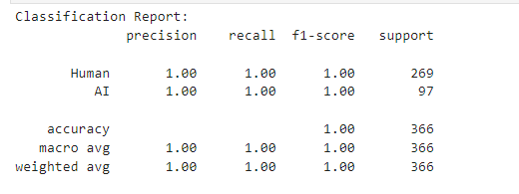
SVM
The SVM model demonstrates perfect performance with a classification accuracy of 100%, achieving a precision, recall, and F1-score of 1.00 for both Human and AI categories.
The results reflect strong generalization across the dataset.

Slide 13
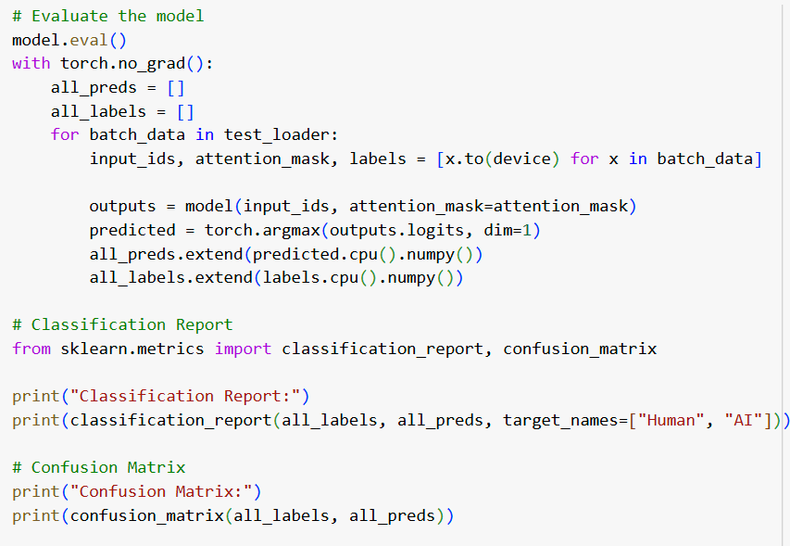
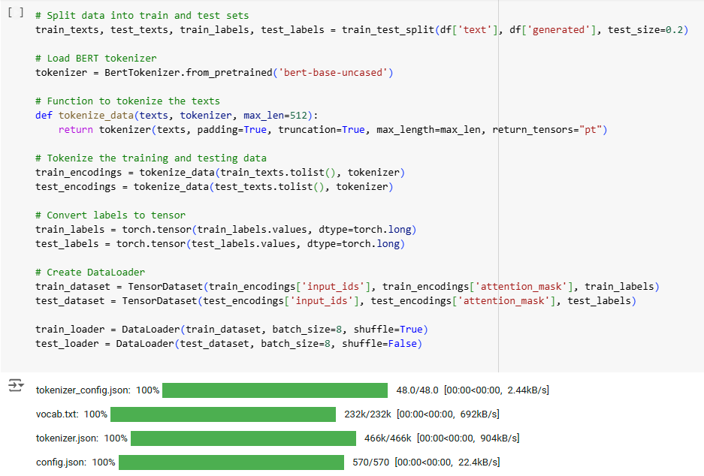
BERT Model
Tokenization: Text data is tokenized using the BERT tokenizer with padding and truncation to ensure consistent input length.
Model: The pre-trained 'bert-base-uncased' model is fine-tuned for binary classification (Human vs. AI).

Slide 14
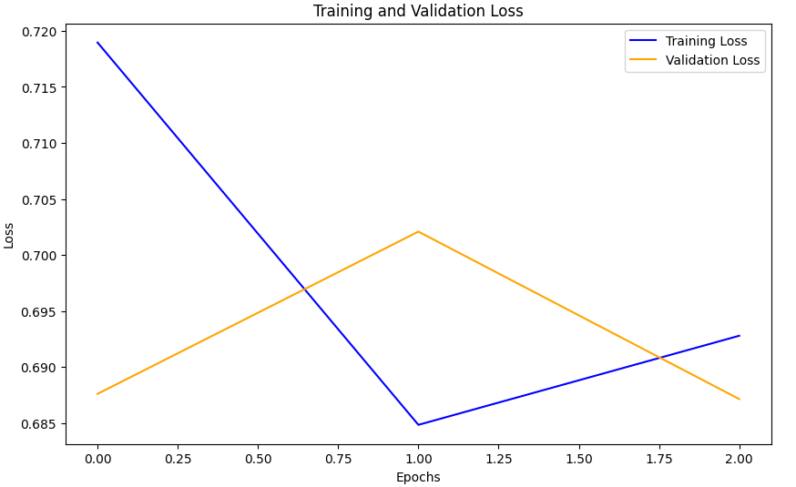
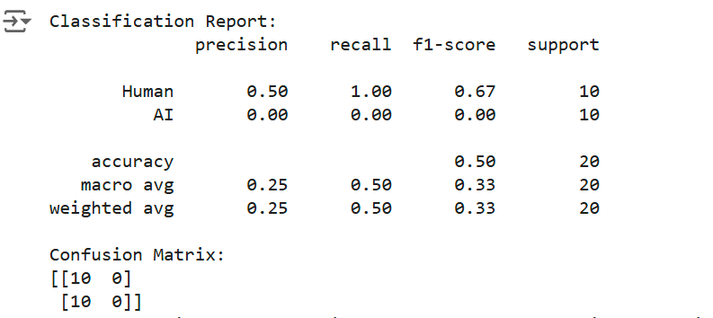
BERT Model
Training Setup: Data loaders feed tokenized inputs to the model. The AdamW optimizer and cross-entropy loss function are used for optimization.
Observations: Initial weights for the classifier are randomly initialized, indicating a need for further fine-tuning on the specific dataset.

Slide 15
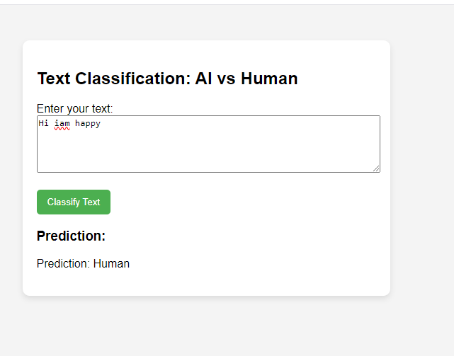
Interface Deployment

Slide 16
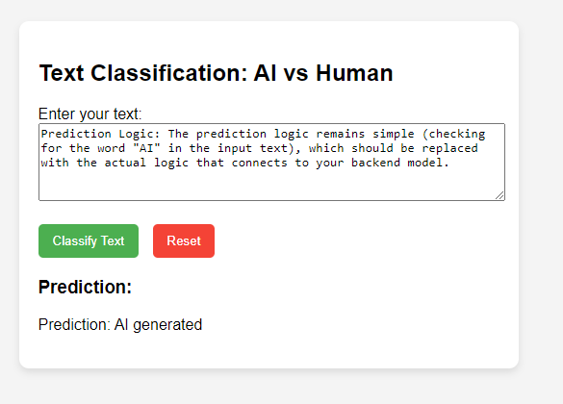
Interface Deployment

Slide 17


Thank you

